Slide 1
Data Structure
2D Array Memory Representation

Slide 2
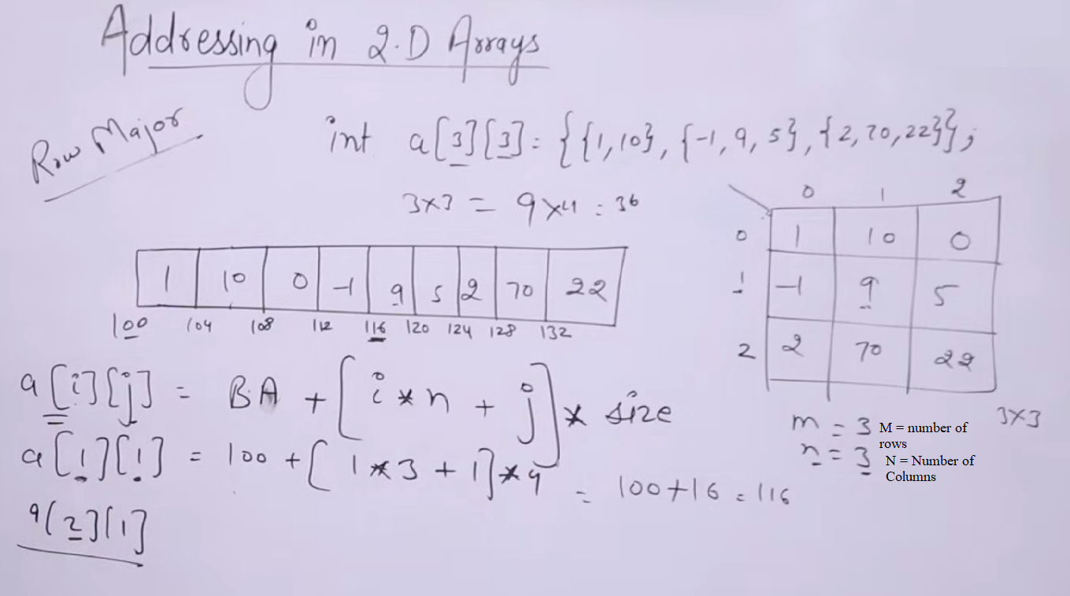

Slide 3
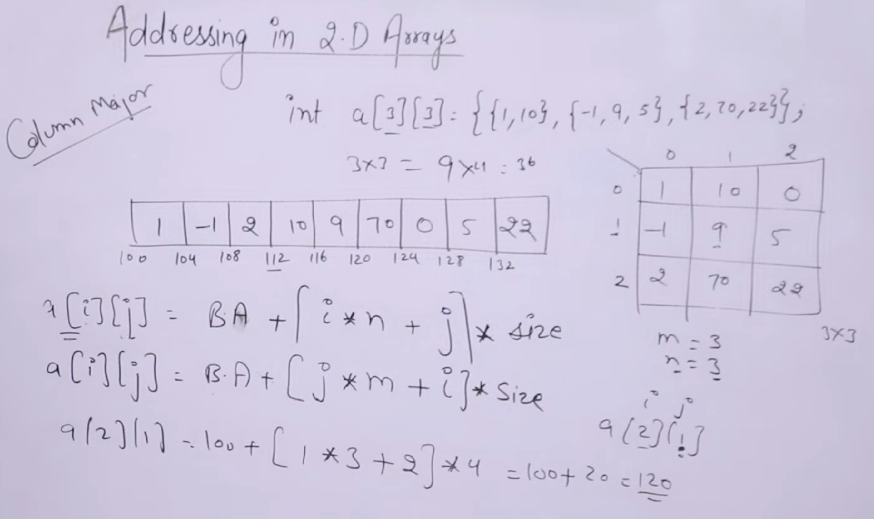

Slide 4
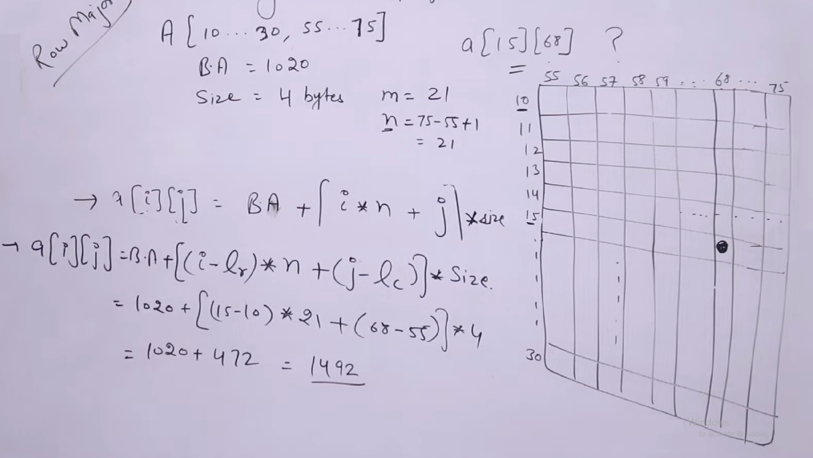

Slide 5
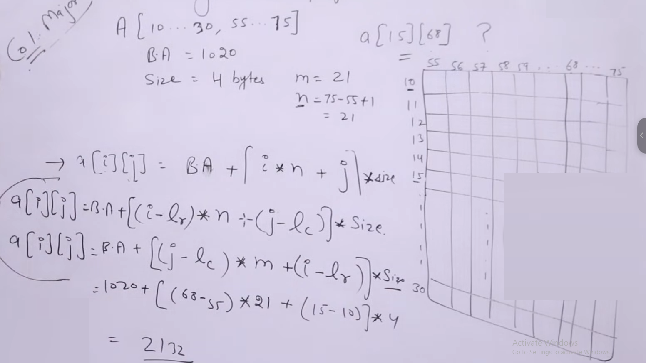

Slide 6
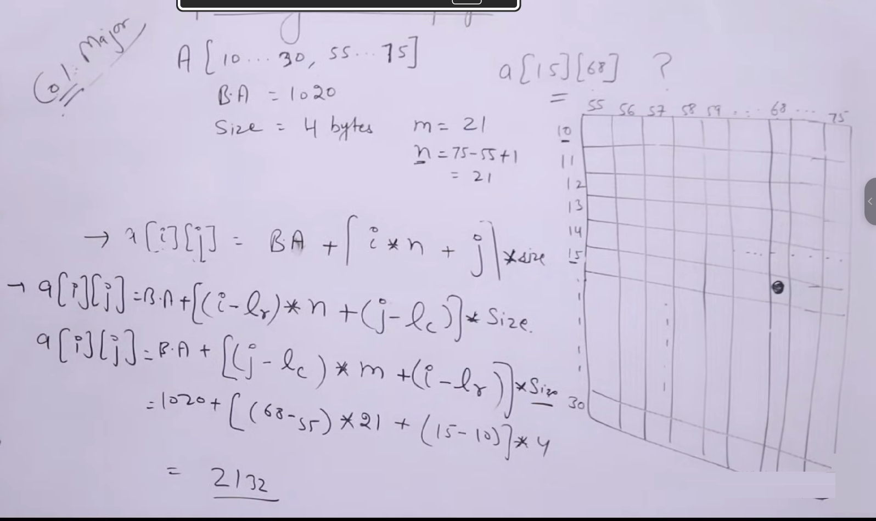

Slide 7
Given, Data (-2:10, -5:5)
Row = L_1 = -2
Row = U_1 = 10
Column = L_2 = -5
Column = U_2 = 5
Base Address = B = 400
Size of each memory cell = Word size = W = 4
Total Rows, M:
M = (U_1 - L_1) + 1
M = (10 - (-2)) + 1 = 10 + 2 + 1 = 13
Total Columns, N:
N = (U_2 - L_2) + 1
N = (5 - (-5)) + 1 = 5 + 5 + 1 = 11
Total Elements = M x N = 13 x 11 = 143

